Slide 1
PERSUASION

Slide 2
DEFINITION
The process of creating, reinforcing or changing people’s beliefs or actions

Slide 3
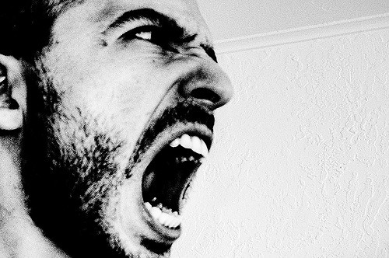
Appeal to the Audience
PATHOS
Emotional appeal
Heart warming stories
Personal experiences
Jokes
Photographs
Examples:
Chicken Soup books
Hallmark commercials
Shelter dogs ads

Slide 4
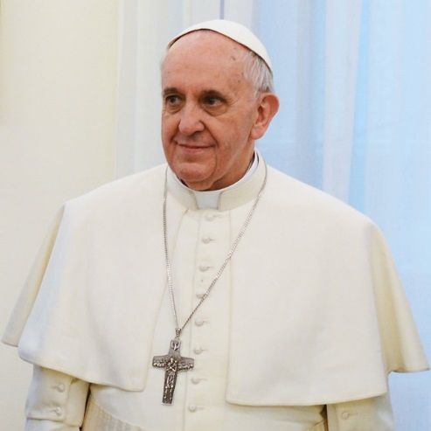
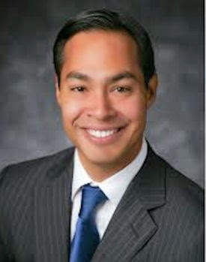
ETHOS
Ethical appeal
Credibility, competence, character
Experts
Customer reviews
Celebrity endorsements
Personal qualifications

Slide 5
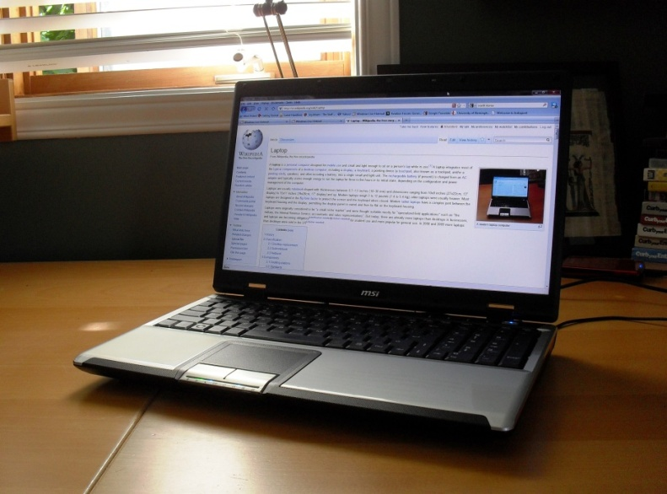
LOGOS
Logical appeal
Use support material (evidence)
Solid reasoning
Statistics
Facts
Reasonable ideas
Logical information

